Slide 1

Suitable courses
Tutor lecture
Jouni Könönen

Slide 2

Content
Suitable courses
Attachment to the eRPL application for studies where there is no transcript of records

Slide 3
Suitable course topics
Game developing with UNITY
C#
Python, Javascript (MEC)
React.js
Microcontrollers
Embedded systems
Machine Learning
AI
Digital Twin

Slide 4



Suitable courses are available
You can choose from three places

Slide 5
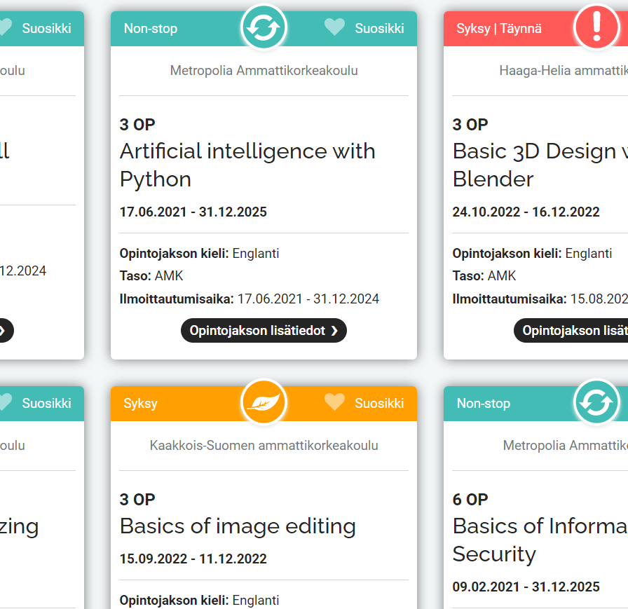
Campus Online Courses Level Applied Scieces
Campus Online https://campusonline.fi/
Fundamentals of Web Development
https://campusonline.fi/course/fundamentals-of-web-development-3/
Artificial intelligence with Python
https://campusonline.fi/course/artificial-intelligence-with-python/
Basic Network Analyzing with Wireshark
https://campusonline.fi/course/basic-network-analyzing-with-wireshark/
NodeJS
https://campusonline.fi/course/nodejs/
React.js fundamentals
https://campusonline.fi/course/react-js-fundamentals/
Advanced Powershell
https://campusonline.fi/course/powershellin-kehittyneet-toiminnot/

Slide 6
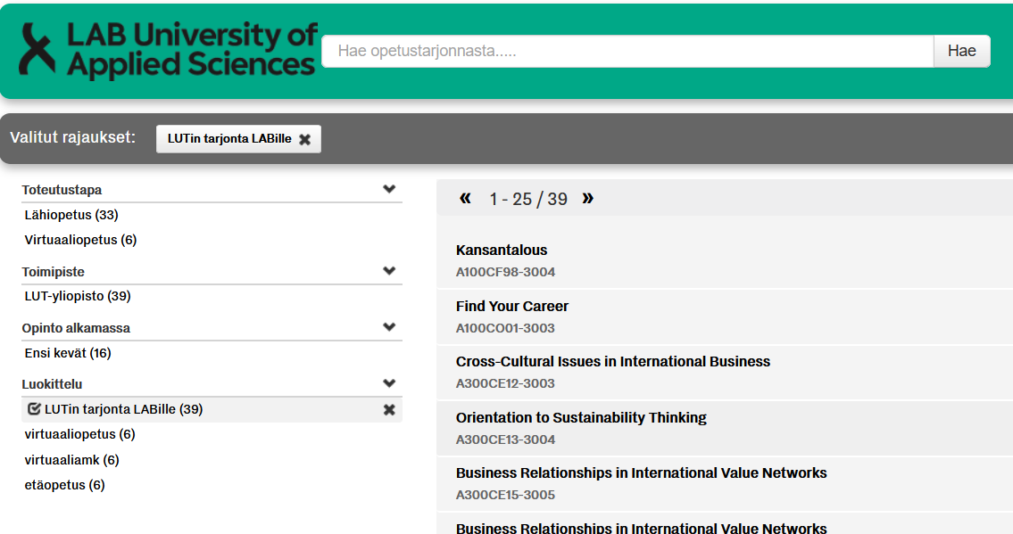
LUT courses for LAB students
https://elab.lab.fi/en/completing-studies/planning-your-studies/lut-study-offerings-labs-students
http://opetustarjontahaku.lab.fi/search.php?setFacet=tagsFacet&term=&field=tags&val=78

Slide 7
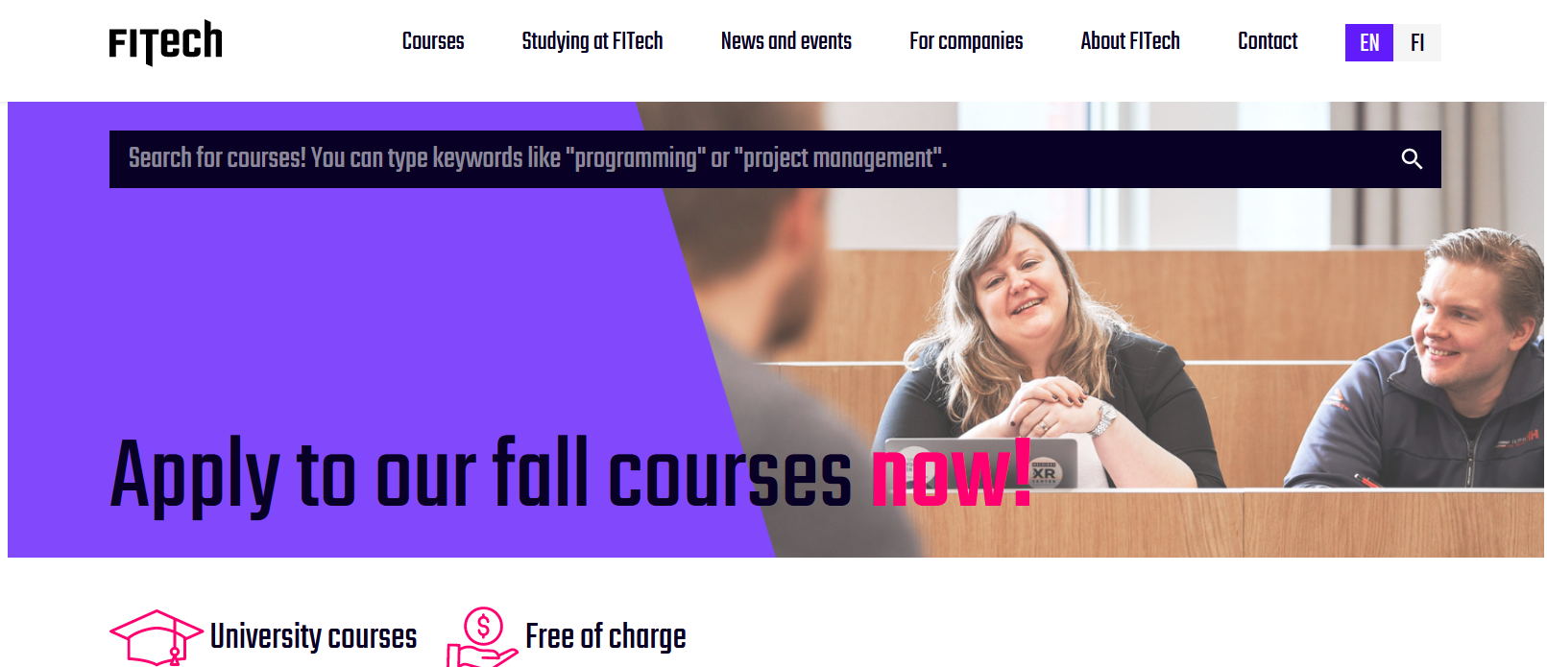
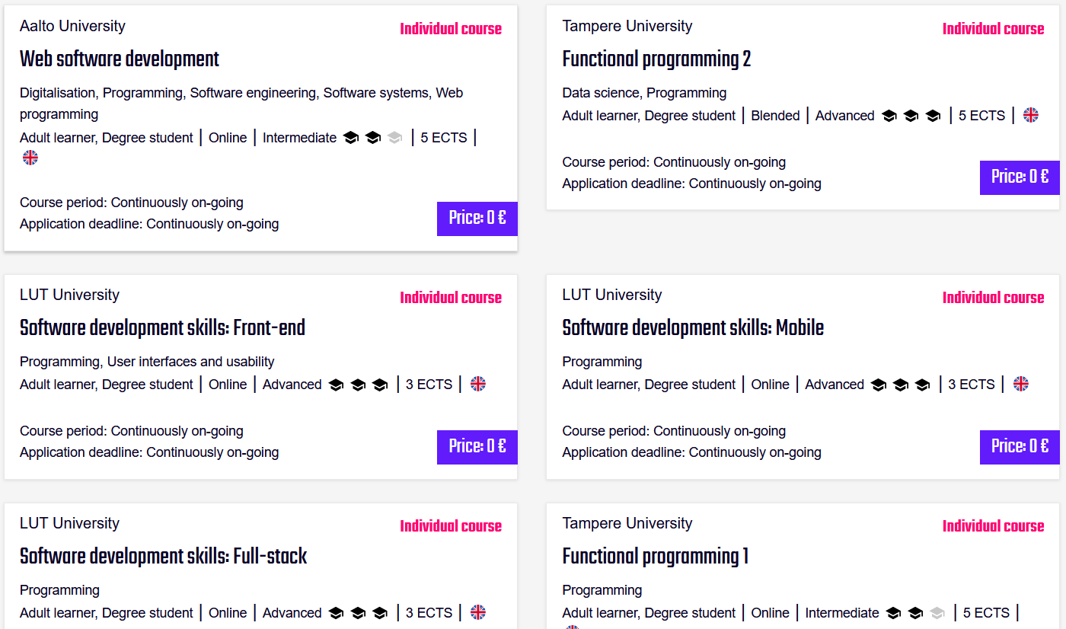
https://fitech.io/
I recommend Fitech courses if you want to learn things, not accumulate credits.
https://fitech.io/

Slide 8
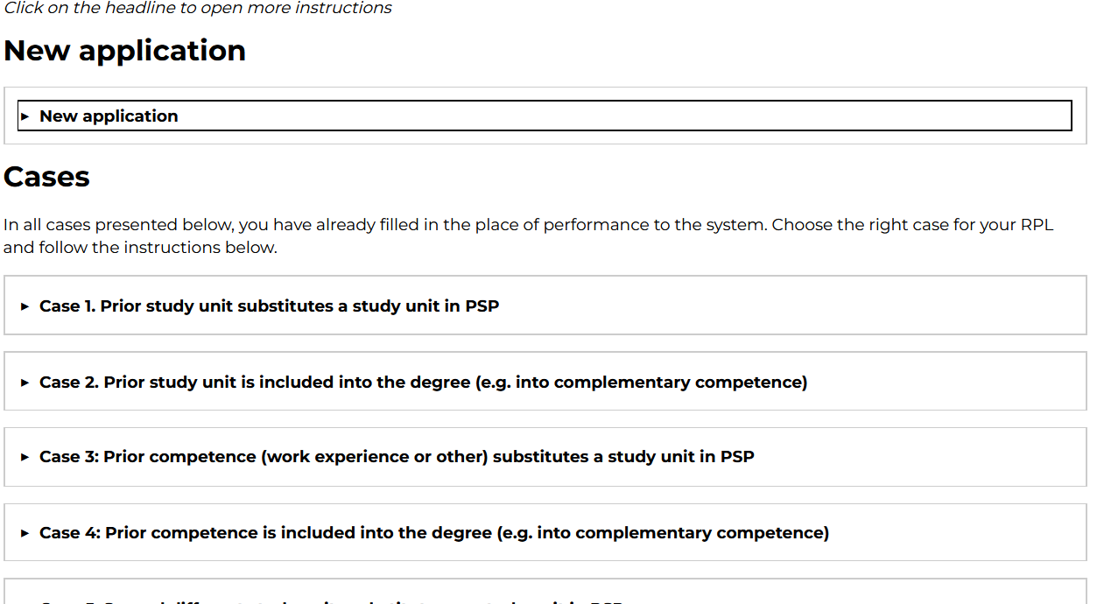
Attachment to the eRPL application for studies where there is no transcript of records
Instructions in eLAB ➔
https://elab.lab.fi/en/it-instructions-study-tools/peppi/peppi-instructions/my-studies-peppi/e-rpl-peppi

Slide 9

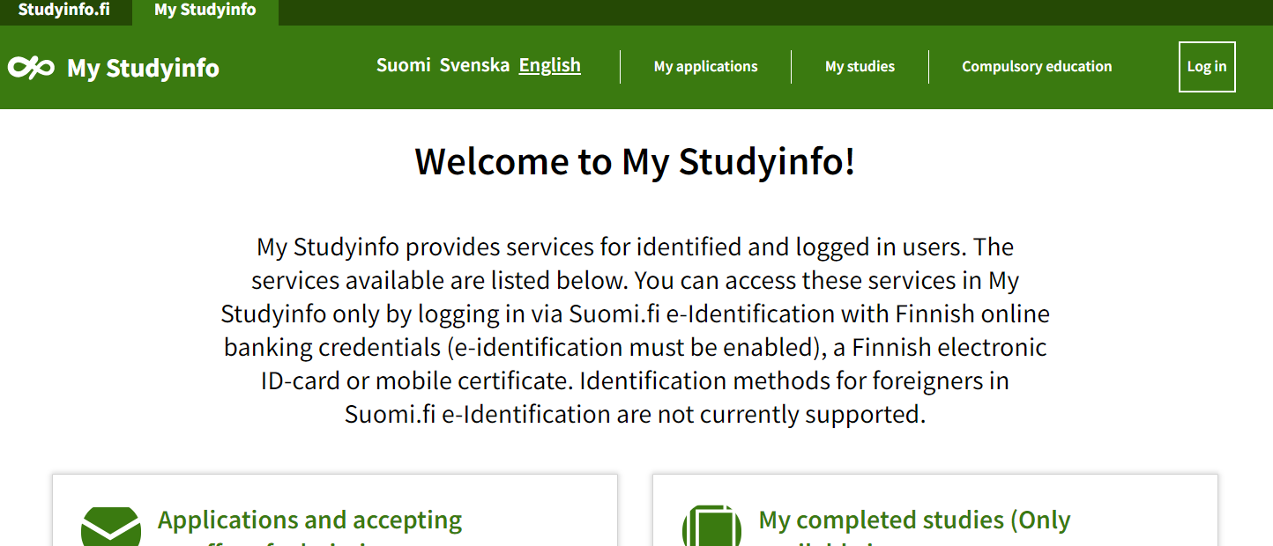
Opintopolku.fi

